Slide 1
Ionic Compounds

Slide 2
Welcome to this Smart Lesson on ionic compounds! After you have completed this lesson you should be able to:
Give the names and chemical formulae of ionic compounds using a given table of ions.
Explain how ionic bonds form between oppositely charged ions due to electrostatic attraction.
Explain why different ionic compounds do not always have the same ratios of positive and negative ions.
Discuss how cations and anions combine to form neutral ionic compounds.

Slide 3
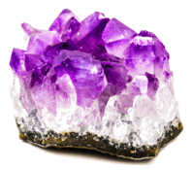
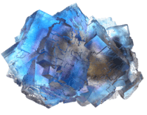
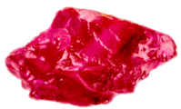
When atoms gain or lose electrons to become stable, they become charged particles: ions.
The electrons are transferred between atoms, forming cations (+) and anions (−). These cations and anions come together to form large crystal lattices called ionic compounds.

Slide 4

Ionic compounds are made up of cations and anions held together by strong electrostatic forces.
Ionic bonds are a type of chemical bond involving electrostatic attraction, which is the attractive force between ions with opposite electric charges.
Positively charged cations and negatively charged anions attract each other and bond together to form an ionic compound.

Slide 5
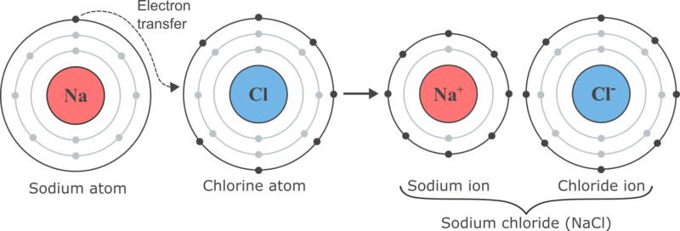
Let's look at the most well-known example of an ionic compound, sodium chloride (table salt).
The sodium atom (a metal) loses an electron to form a sodium ion (Na+). The electron is transferred to the chlorine atom (a non-metal). When chlorine gains the electron, a chloride ion (Cl−) is formed. The oppositely charged sodium and chloride ions are attracted to each other, and bond together to form the compound sodium chloride (NaCl).

Slide 6
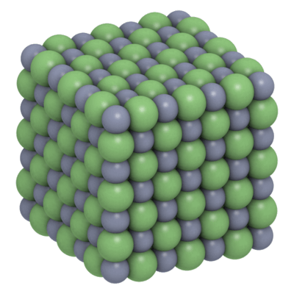
Unlike covalent compounds, such as water (H₂​O), ionic compounds do not contain individual molecules. Instead, they form crystal lattices.
A crystal lattice is a repeated arrangement of ions in 3 dimensions. For example, the image below shows what the structure of a sodium chloride crystal would look like up close. Each cation in the lattice is surrounded by anions, and each anion is surrounded by cations.

Slide 7
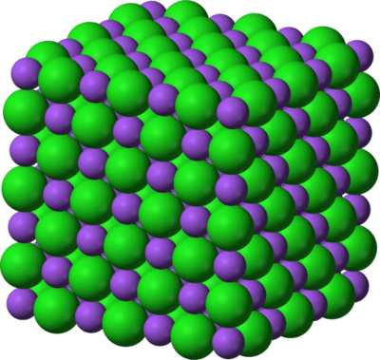
Ionic compounds are always neutral (uncharged) overall.
Positive charges (from cations) and negative charges (from anions) need to cancel each other out.
If the charges on the cations and anions are the same (e.g. 1+ and 1−), a simple crystal lattice with equal numbers of anions and cations is formed.

Slide 8
Once we've figured out the ratio of cations to anions in an ionic compound, we can write its chemical formula.
Writing a chemical formula for an ionic compound is a way of showing how many of each type of ion you need in order for the compound to be neutral.
The formula is written:
Cation first, anion second.
Showing the simplest ratio of ions that balances the positive and negative charges.
Without showing charges on ions.

Slide 9
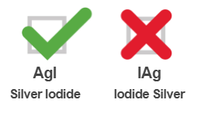
When writing the name or formula of an ionic compound, the metal ion (cation) is always written first and the non-metal ion (anion) is always written second. The charges on the ions are not included in the chemical formula.
For example, an ionic compound made up of silver (Ag+) and iodide (I−) ions is called silver iodide and not iodide silver.
Its chemical formula is written AgI and not IAg.

Slide 10
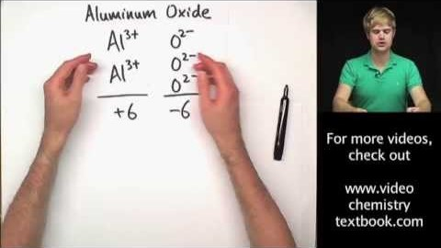
Watch the video below (6:12) for a recap of how to write ionic formulae.

